Slide 1
‘Glass Half Full or Empty’:
Illuminating the Human Transcriptome
Lecture 2

Slide 2
Any questions from last class?
Notes:
https://en.wikipedia.org/wiki/File:DNA_simple.svg

Slide 3
Worksheet Answers!
(from last class)
Notes:
https://en.wikipedia.org/wiki/File:DNA_simple.svg

Slide 4
Let’s review some big themes!
Central dogma of biology
DNA has two strands that pair with each other
Alternative splicing
Notes:
https://en.wikipedia.org/wiki/File:DNA_simple.svg

Slide 5
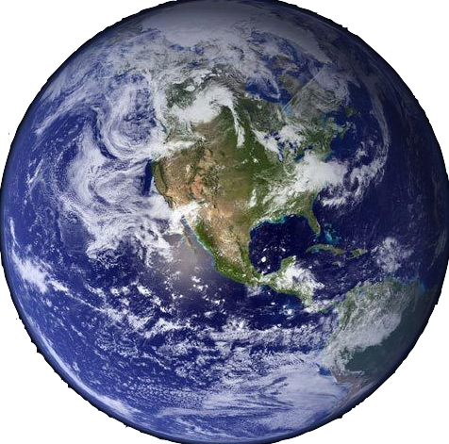
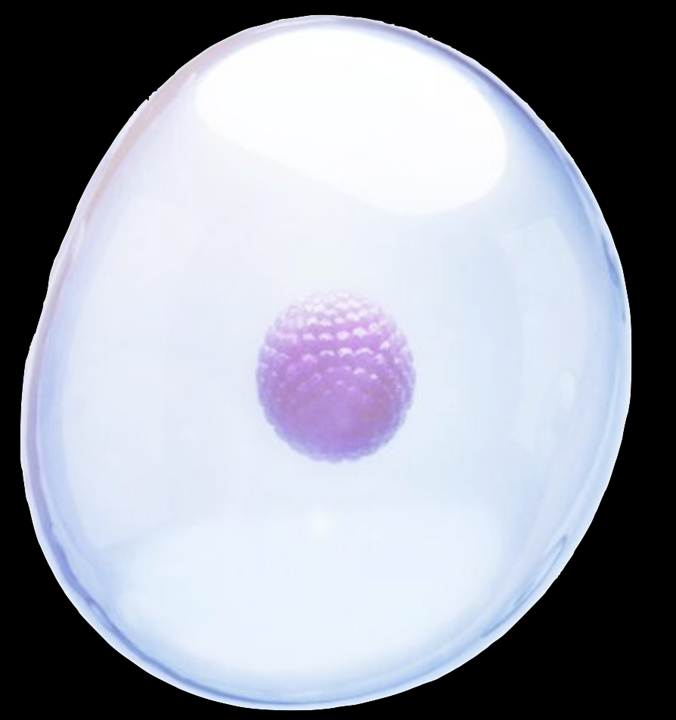
The World of Biology
The Cell
Notes:
image: https://www.genome.gov/genetics-glossary/Deoxyribonucleic-Acid

Slide 6
The Central Dogma
Nucleus => DNA
RNA
Protein
Cytoplasm
The Cell

Slide 7
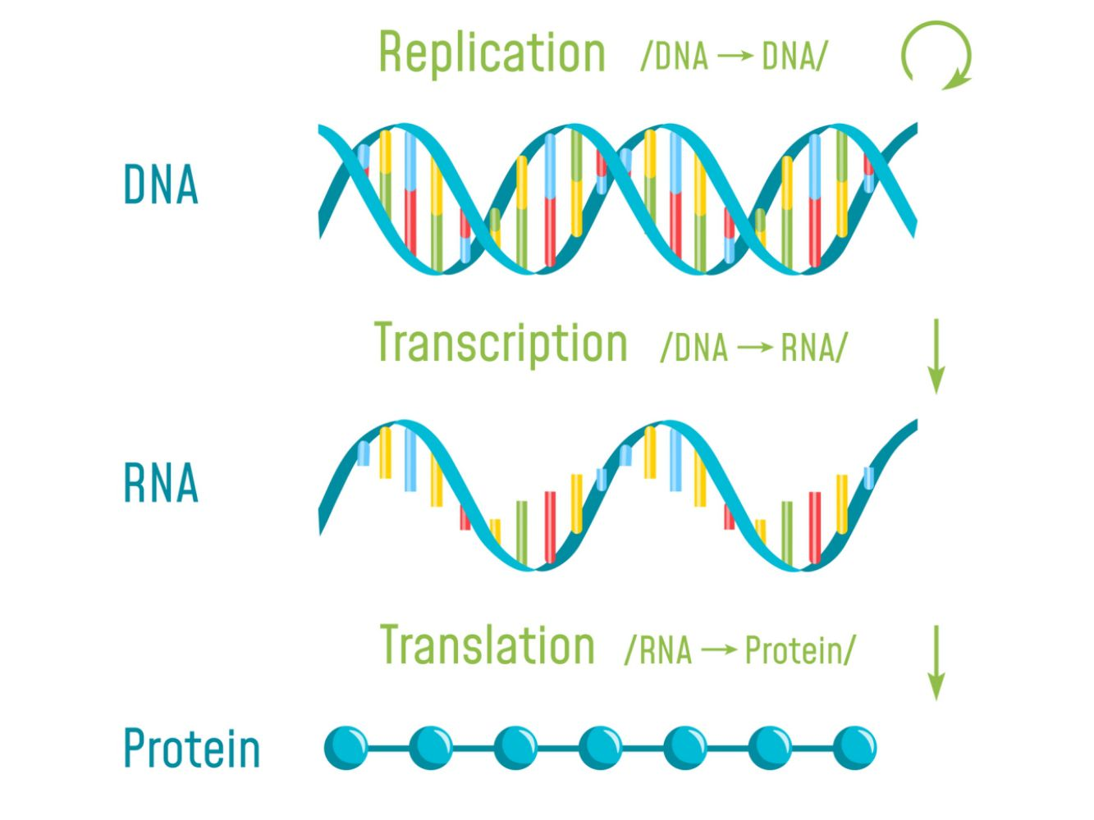
The Central Dogma

Slide 8


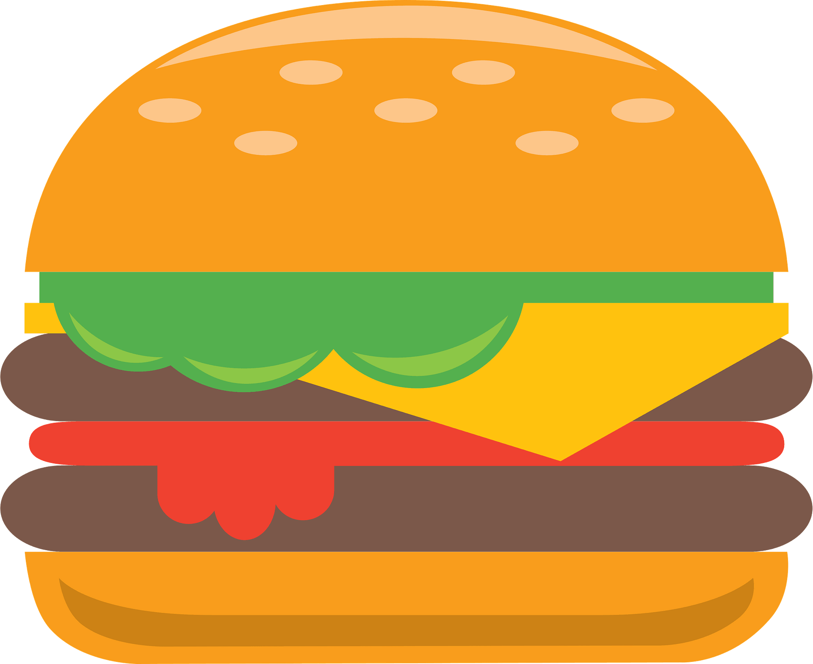
The Central Dogma
DNA
RNA
Protein
Eggs
Beef
Cheese
Bacon
Lettuce
Pickles
Tomato
Bread
Mayo

Slide 9
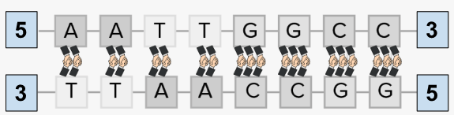
DNA has two strands that base pair with each other
NOTICE: The 5’ end of one strand pairs with the 3’ end of the other!

Slide 10
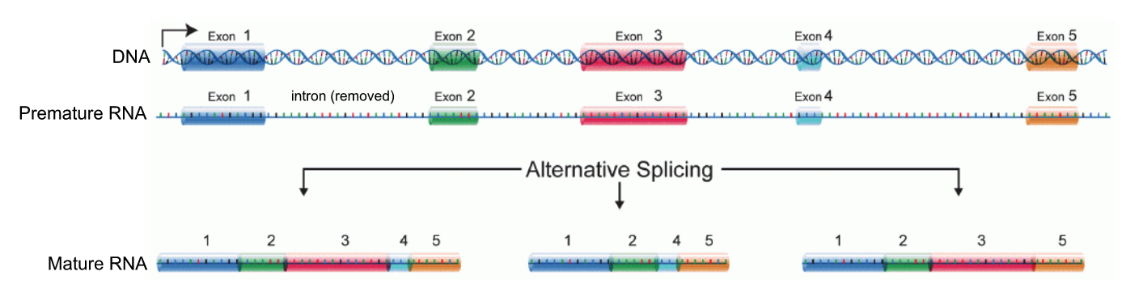
Alternative splicing
Nucleus => DNA
RNA
The Cell

Slide 11
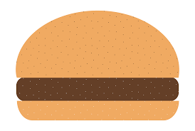
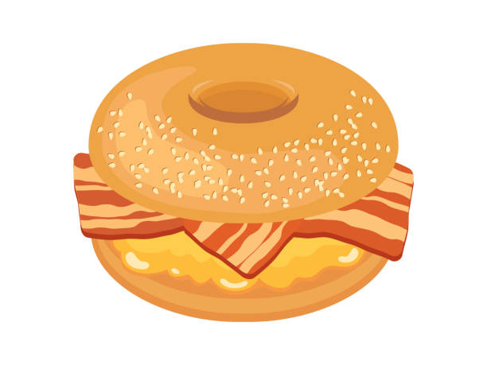
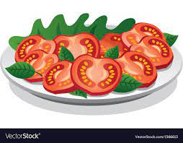
Alternative splicing
DNA
RNA
Protein
Eggs
Beef
Cheese
Bacon
Lettuce
Pickles
Tomato
Bread
Mayo
Eggs
Beef
Cheese
Bacon
Lettuce
Pickles
Tomato
Bread
Mayo
Eggs
Beef
Cheese
Bacon
Lettuce
Pickles
Tomato
Bread
Mayo
Eggs
Beef
Cheese
Bacon
Lettuce
Pickles
Tomato
Bread
Mayo

Slide 12
So… what’s next?
Notes:
https://en.wikipedia.org/wiki/File:DNA_simple.svg

Slide 13
You are working on a NOVEL research project!
So…. what’s the research question?

Slide 14

Can we predict NEW transcripts (mature RNA) and prove that they exist?

Slide 15
Yes!!!
Predict new transcripts (RNA)
Harvest transcripts (as stable DNA) from cells
Amplify your transcript
Isolate your transcript
Sequence the transcript

Slide 16
Yes!!!
Predict new transcripts (RNA)
Harvest transcripts (as stable DNA) from cells
Amplify your transcript
Isolate your transcript
Sequence the transcript

Slide 17
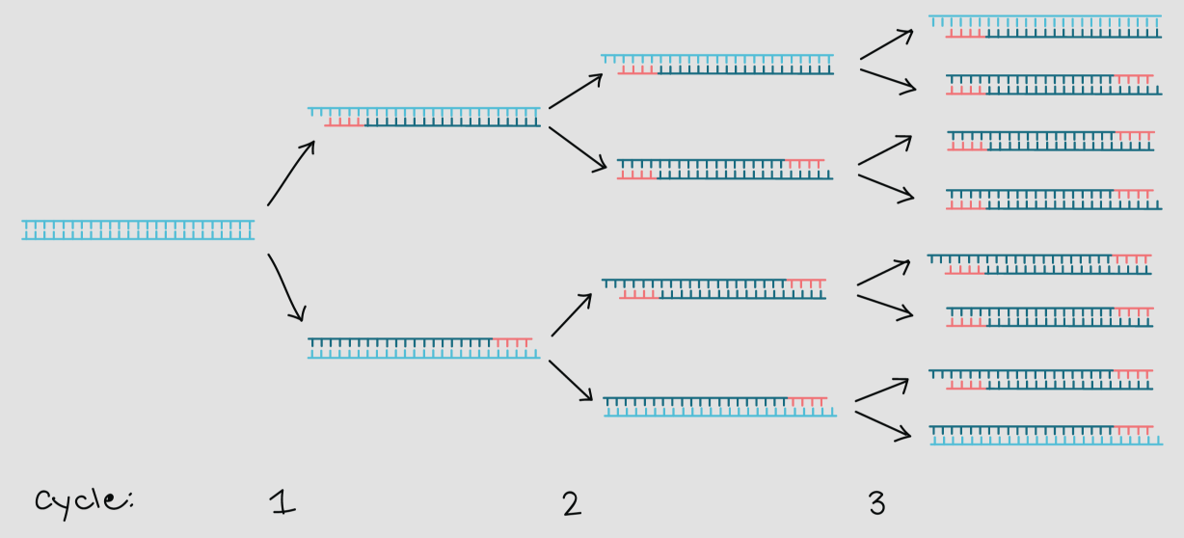
Polymerase chain reaction (PCR)

Slide 18
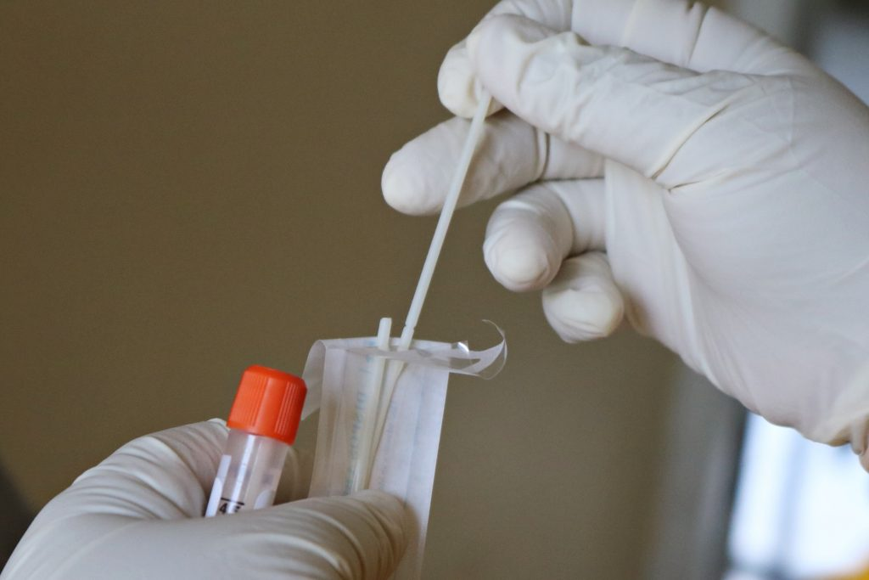
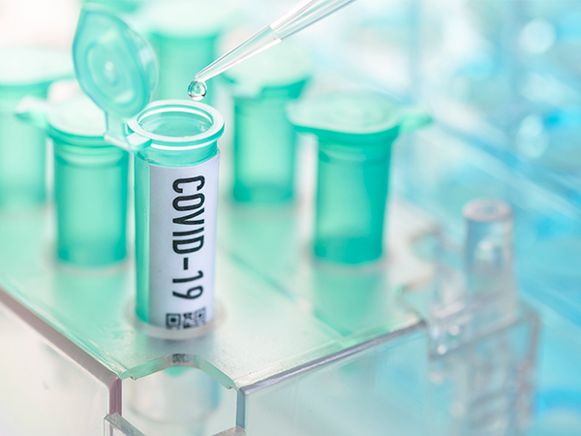
Polymerase chain reaction (PCR)
Where have you heard this term…

Slide 19
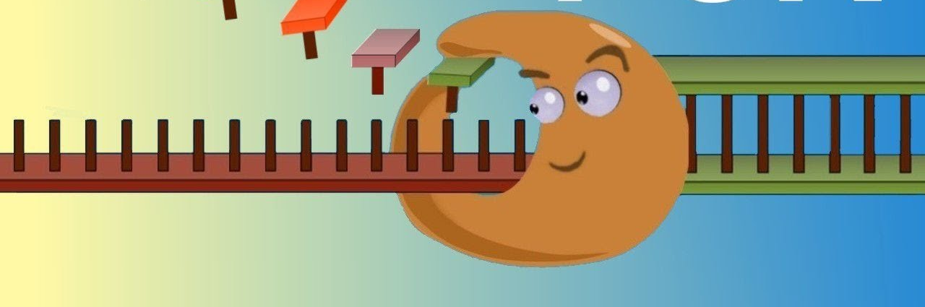
Polymerase chain reaction (PCR)
… is inspired by DNA replication!
DNA polymerase
‘the DNA builder’

Slide 20
Polymerase chain reaction (PCR)
DNA polymerase needs 3 things
Template DNA (red)
Primer (yellow) = ‘an anchor’
New bases
3’
5’

Slide 21
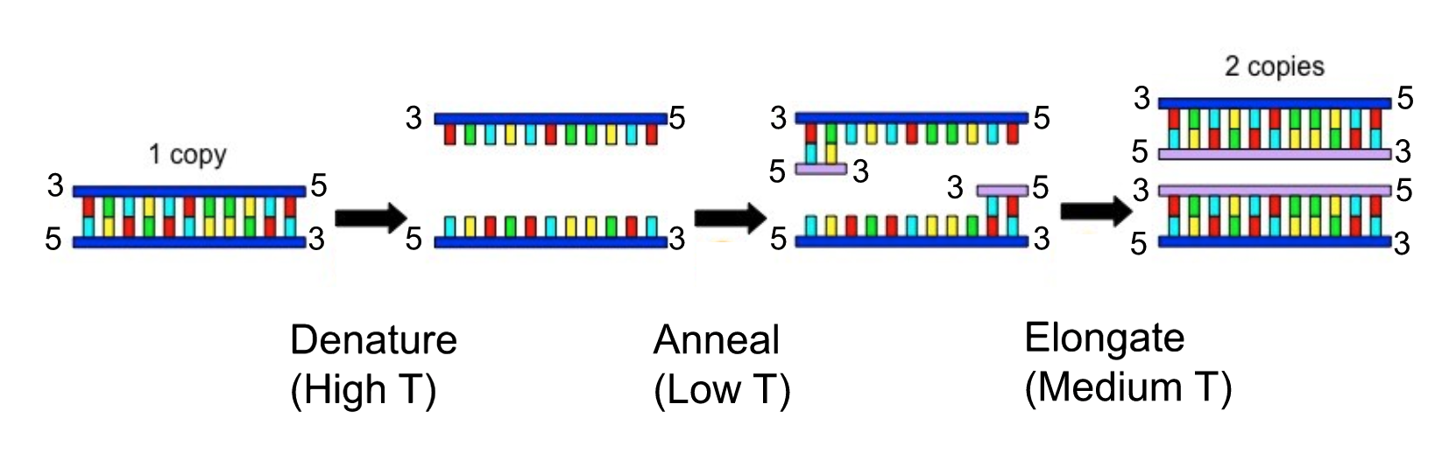
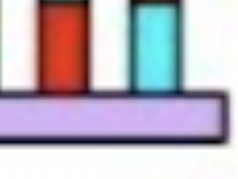
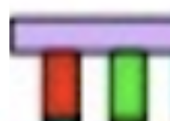
Polymerase chain reaction (PCR)
5
5
5
3
3
3
forward ->
3
5
3
5
5
3
<- reverse
5
3
5
3
3
5
3
5
3
5
3
5
3’
5’
Notes:
Important ideas about annealing:
Primers bind where they can match the template strand. Mismatches prevent tight bonding, so DNAP cannot use as an anchor.
Annealing temp is important. Lower annealing temp = more cooling = more bond formation, which can cause non-perfect matches to anneal and serve as anchors, giving you unintended products.

Slide 22
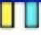
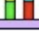

Polymerase chain reaction (PCR)
5’-AG-3’
same as top strand
What’s the sequence of the 2-base forward primer?
What’s the sequence of the 2-base reverse primer?
5’-AG-3’
‘reverse complement’ of top strand 5’-CT-3’
Answer by writing it in the 5’ -> 3’ orientation.
5
5
A GT C T A GGC CT
3
3
5
A GT C T A GGC CT
forward
3
5
3
3
reverse
5
3
5
3
5
3
5
T CA G A TC C GGA
T CA G A TC C GGA
Notes:
Note: The forward primer is the same sequence as the top strand (which is normally what you will be provided).
Note: The reverse primer is the same as the complementary strand, but in reverse (since it needs to be 5’ -> 3’), hence ‘the reverse complement’
Introduce:
Complement (A->T, G->C, etc.)
Reverse complement (3->5 to 5->3)

Slide 23
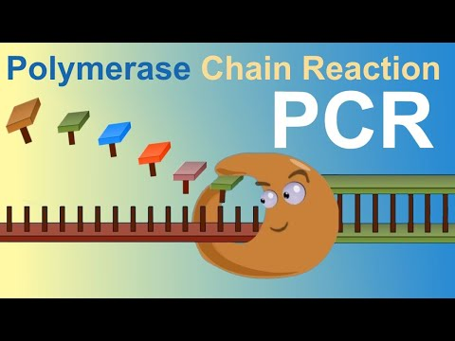
Polymerase chain reaction (PCR)

Slide 24
Worksheet Time!
Notes:
https://en.wikipedia.org/wiki/File:DNA_simple.svg

Slide 25
Time to select some transcripts
& design some primers!
Notes:
https://en.wikipedia.org/wiki/File:DNA_simple.svg

Slide 26
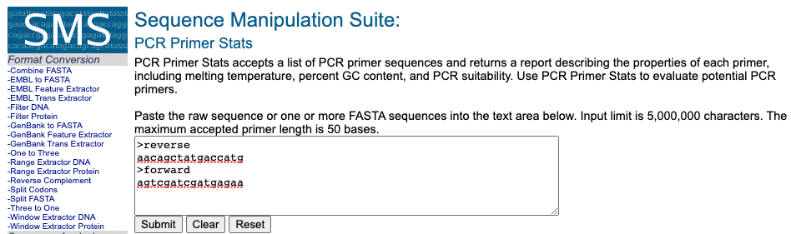
After designing primers go to…
https://www.bioinformatics.org/sms2/pcr_primer_stats.html

